Slide 1
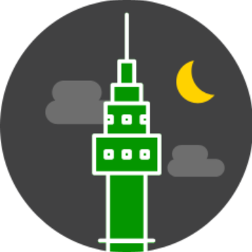
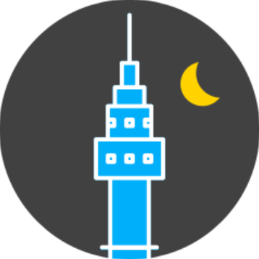
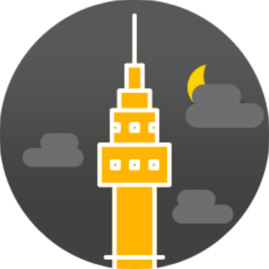
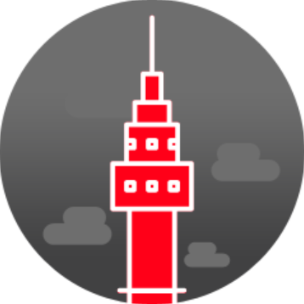

Slide 2


Slide 3





Slide 4


Slide 5


Slide 9





Slide 10
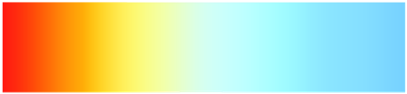
Color Temperature Scale
1,000
2,500
5,000
7,500
10,000

Slide 11
Color Temperature Scale
1,000
2,500
5,000
7,500
10,000

